Slide 1
Mini Project on
Skin Lesion Segmentation
Under Guidence Of : Presented By :
Dr BH Shekar Name :Bhawya devi
Reg No : P05AZ23S038006

Slide 2
Contents :
Introduction
Problem Statement
Methodology
Experiments and Results
Conclusion
References

Slide 3
Introduction:
Skin cancer is one of the most common and life-threatening diseases worldwide, making early detection crucial for effective treatment.
Traditional diagnostic methods rely on manual examination by dermatologists, which can be time-consuming and prone to subjectivity.
To address this, automated skin lesion segmentation using deep learning has emerged as a powerful approach.

Slide 4
In this project, we implement a deep learning-based segmentation model to accurately detect and segment skin lesions from dermoscopic images.
Here, we employ the U-Net model, a powerful convolutional neural network (CNN) specifically designed for biomedical image segmentation. The U-Net architecture enables precise boundary detection of skin lesions, aiding dermatologists in early diagnosis and treatment planning.

Slide 5
Problem Statement
Accurate segmentation of skin lesions in dermoscopic images is a challenging task due to variations in shape, size, texture, and illumination. Traditional image processing techniques often struggle to achieve high precision in detecting lesion boundaries.
This project focuses on developing an automated skin lesion segmentation model using the U-Net architecture. The objective is to:
Improve segmentation accuracy to assist dermatologists in diagnosing skin cancer.
Reduce the dependency on manual annotations, which are time-consuming and prone to inconsistencies.
Enhance model generalization across different lesion types and imaging conditions.
By addressing these challenges, the project aims to contribute to more reliable and efficient skin cancer diagnosis using deep learning.

Slide 6
Advantages of Automatic Skin Lesion Segmentation
Higher Accuracy & Consistency
Traditional methods rely on manual examination, which is subjective and prone to human error.
Automatic segmentation using deep learning ensures higher accuracy and consistency, reducing variability between dermatologists.
Faster Diagnosis
Manual segmentation is time-consuming and requires expert intervention.
AI-based segmentation provides real-time or near-instant results, aiding in quicker diagnosis and treatment.
Handles Complex Lesions
Traditional methods struggle with irregular, low-contrast, or overlapping lesions.
U-Net and deep learning models can effectively learn patterns and segment complex lesion structures accurately.

Slide 7
Dataset :
PH2 Dataset
For this project, we will be training the model on the PH2 dataset, which is widely used for skin lesion segmentation in medical imaging. The dataset is publicly available and contains dermoscopic images of skin lesions with corresponding ground-truth masks.
The dataset used for this project consists of:
Training Images: 360
Test Images: 155
Validation Images: 67
Annotation Format: Binary masks for lesion segmentation
Dataset Link :
https://www.kaggle.com/datasets/athina123/ph2dataset

Slide 8
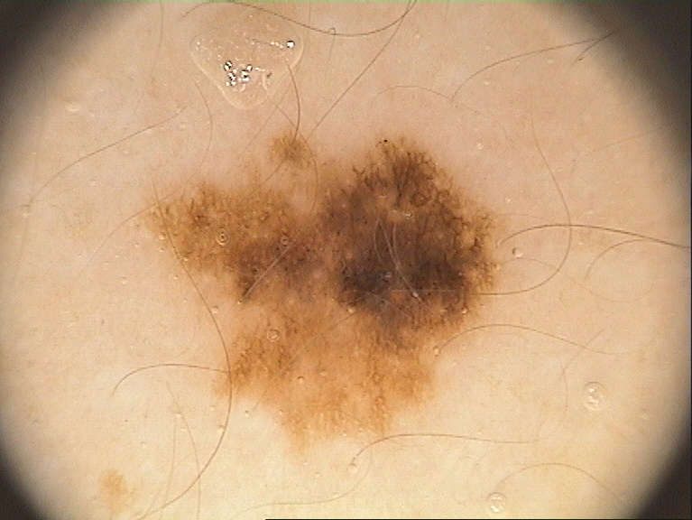
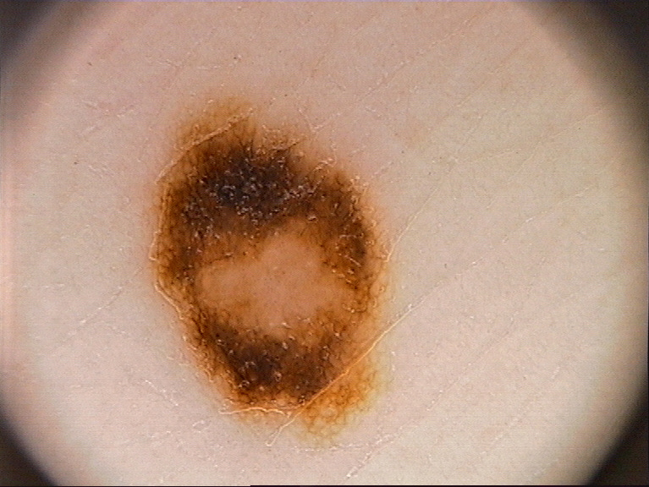
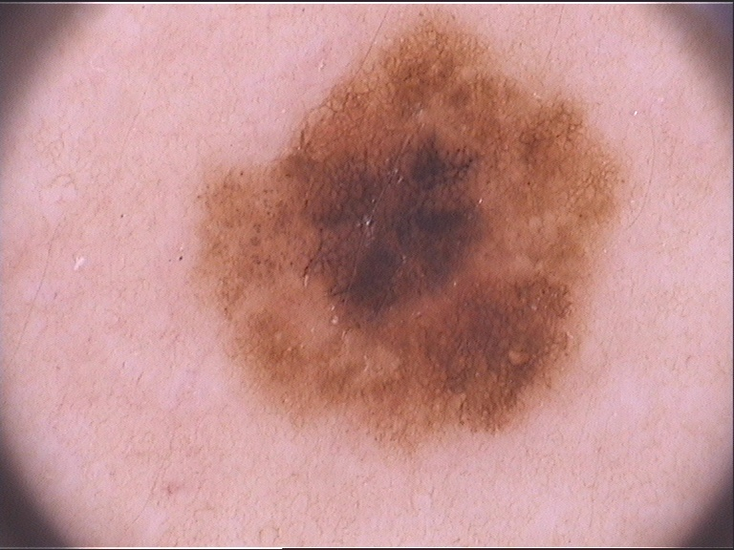
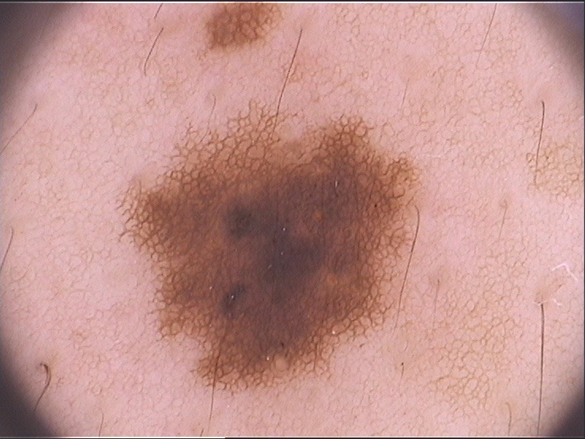
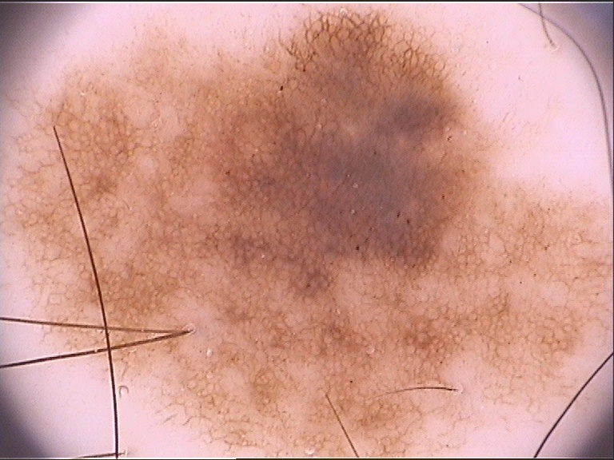
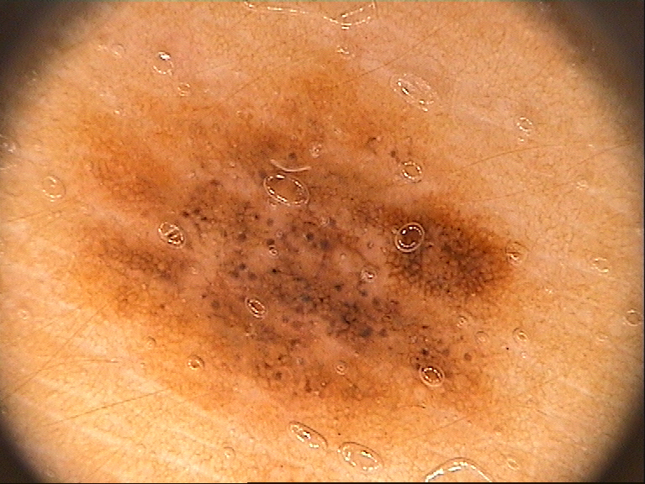
Sample Images :

Slide 9
Preprocessing Techniques
METHODOLOGY
Preprocessing is essential to enhance image quality and ensure consistent input to the model.
Image Resizing:
All images are resized to 224 × 224 pixels to maintain uniform input size for the U-Net model.
Normalization:
Pixel values are scaled to [0,1] by dividing by 255 to improve training efficiency and stability.
Conversion to NumPy Array:
The resized images are converted into NumPy arrays using np.array(). This is necessary for feeding the data into the Keras model.

Slide 10
METHODOLOGY
Augmentation Techniques:
Random Rotation:
The random_rotation function applies random rotations to both the input image and the corresponding mask. The rotation angle is randomly chosen between -40 and 40 degrees. This technique helps the model learn to be invariant to rotations in the input data.
Horizontal Flipping:
The horizontal_flip function flips both the input image and the mask horizontally. This increases the diversity of the training data and helps the model generalize better.
Concatenation of Augmented Data:
The augmented images (rotated and flipped) are concatenated with the original training data using np.concatenate. This expands the training set and improves the model's robustness.

Slide 11
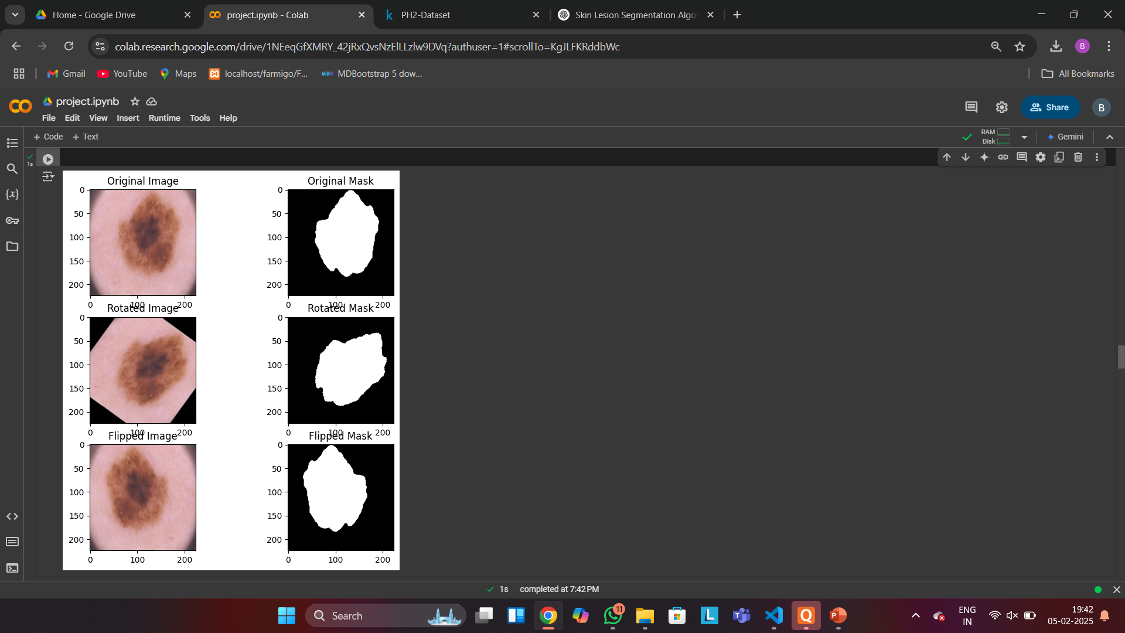
Images after doing Augmentation Techniques :

Slide 12
Feature Extraction
METHODOLOGY
Feature extraction automatically derives relevant features from input data using neural network layers. In this work, the model learns and extracts features during training, enhancing segmentation accuracy without manual intervention.

Slide 13
Model Used : U-Net
METHODOLOGY
There are several deep learning models available for image segmentation, including SegNet, FCN, and U-Net.
In this project, the U-Net architecture was chosen for skin lesion segmentation.
U-Net follows an encoder-decoder architecture that make it highly effective for segmentation tasks, particularly where the goal is to identify and segment objects in an image (like skin lesions).

Slide 14
U-Net Architecture
U-Net is a deep learning model designed for biomedical image segmentation. It follows a U-shaped architecture consisting of two main parts:
Contracting Path (Encoder) – Extracts important features using convolutional layers and downsampling through max pooling, reducing spatial dimensions while capturing context.
Expanding Path (Decoder) – Uses transposed convolutions (upsampling) to restore the spatial resolution and refine segmentation.
Skip Connections – Directly connect encoder and decoder layers to retain fine details and improve segmentation accuracy.
U-Net is widely used in medical imaging due to its ability to generate precise segmentations even with limited training data.

Slide 15
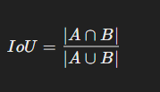
Experiments and Results
Evaluation Metrics
Intersection over Union (IoU)
It is used to measure the overlap between the predicted and ground truth regions. It measures the overlap between predicted and ground truth segmentation masks, calculated as the ratio of their intersection to their union.
Formula:

Slide 16
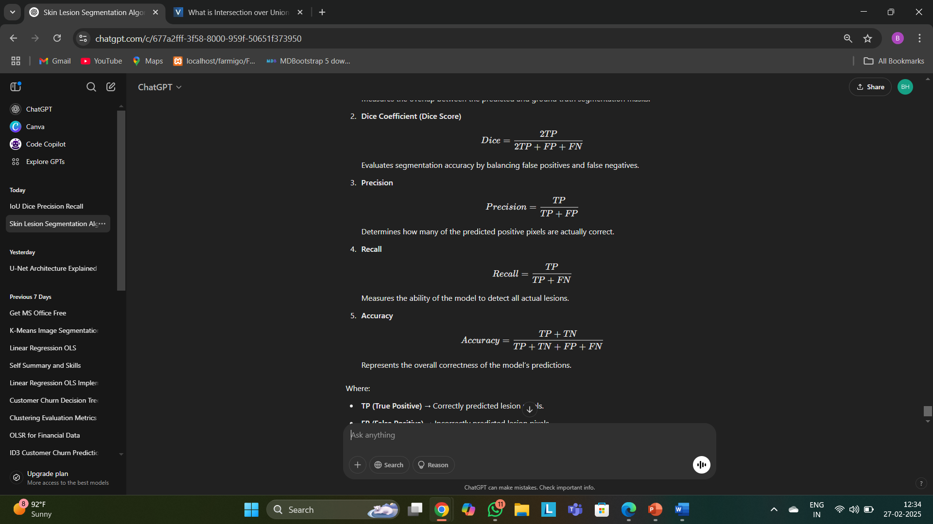
Precision
Determines how many of the predicted positive pixels are actually correct, indicating the model’s reliability in detecting lesions.
Formula :
Recall
Measures how well the model identifies all actual lesions, ensuring minimal false negatives
Formula :

Slide 17
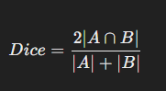
Dice Coefficient (Dice Score)
Evaluates segmentation accuracy by considering both precision and recall, providing a balance between false positives and false negatives.
Formula :
Accuracy
Represents the overall correctness of the model’s predictions by comparing the number of correctly classified pixels to the total pixels.
Formula :

Slide 18
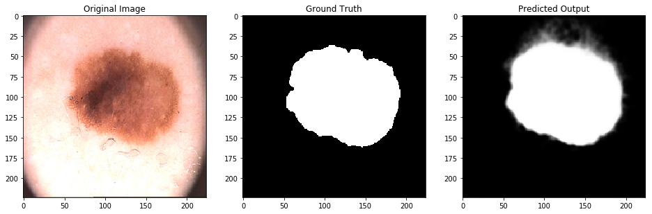
Result :

Slide 19
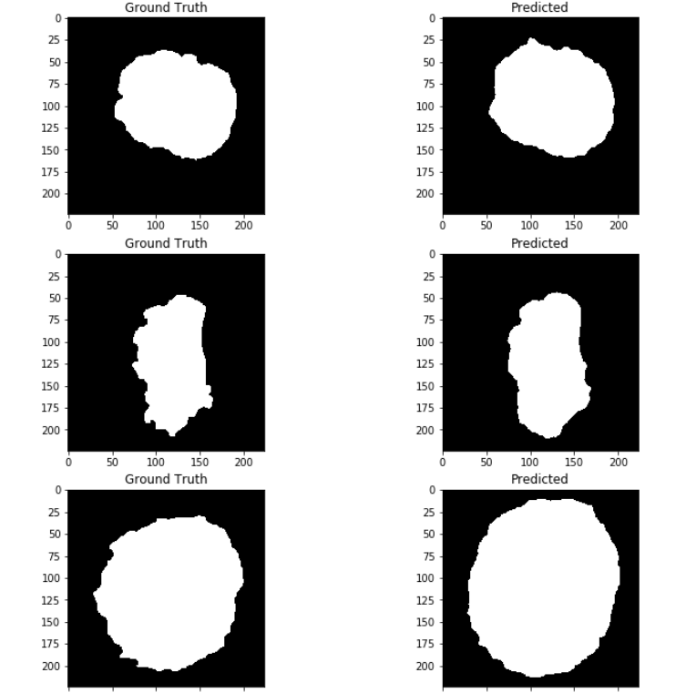
Result :

Slide 20
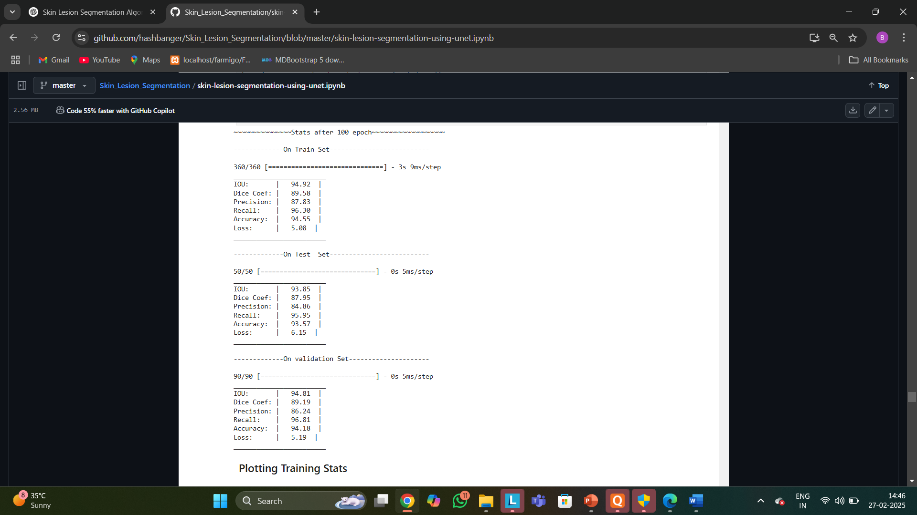
Evaluation Matrix

Slide 21
Conclusion
This project successfully implements skin lesion segmentation using the U-Net model, demonstrating the effectiveness of deep learning in medical image analysis. By leveraging advanced feature extraction and segmentation techniques, the model accurately identifies skin lesions, aiding in early diagnosis and treatment.
In summary, this project helps in automating skin lesion detection, making it faster, more accessible, and more reliable. Future improvements, like using better models or advanced techniques, can further increase accuracy and performance.

Slide 22
Reference:
Fahad Shamshad, Salman Khan, Syed Waqas Zamir, Muhammad Haris Khan, Munawar Hayat, Fahad Shahbaz Khan, and Huazhu Fu, “Transformers in Medical Imaging: A Survey ”
Prashant Brahmbhatt, Siddhi Nath Rajan, "Skin Lesion Segmentation using SegNet with Binary CrossEntropy", International Conference on Artificial Intelligence and Speech Technology (AIST2019) 14-15th November, 2019.

Slide 23
THANK YOU

